Slide 1
Data Mining: Association Analysis
Tom Heskes

Slide 2
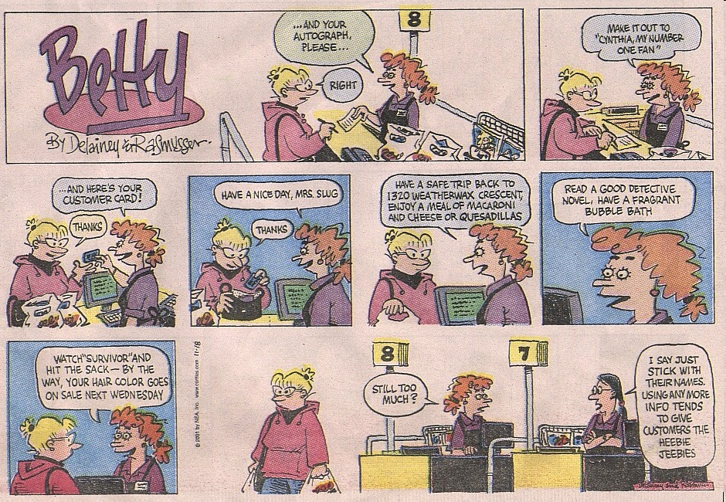

Slide 3
Association Rule Mining
Given a set of transactions, find rules that will predict the occurrence of an item based on the occurrences of other items in the transaction
Market-Basket transactions
Example of Association Rules
{Diaper} → {Beer}, {Milk, Bread} → {Eggs,Coke}, {Beer, Bread} → {Milk},
Implication means co-occurrence, not causality!

Slide 4
Definition: Frequent Itemset
Itemset
A collection of one or more items
Example: {Milk, Bread, Diaper}
k-itemset
An itemset that contains k items
Support count (σ)
Frequency of occurrence of an itemset
E.g. σ({Milk, Bread, Diaper}) = 2
Support
Fraction of transactions that contain an itemset
E.g. s({Milk, Bread, Diaper}) = 2/5
Frequent itemset
An itemset whose support is greater than or equal to a minsup threshold

Slide 5
Definition: Association Rule
Association rule
An implication expression of the form X → Y, where X and Y are itemsets
Example: {Milk, Diaper} → {Beer}
Rule evaluation metrics
Support (s): Fraction of transactions that contain both X and Y
Confidence (c): Measures how often items in Y appear in transactions that contain X
Example:

Slide 6
Association Rule Mining Task
Given a set of transactions T, the goal of association rule mining is to find all rules having
support ≥ minsup threshold
confidence ≥ minconf threshold
Brute-force approach:
List all possible association rules
Compute the support and confidence for each rule
Prune rules that fail the minsup and minconf thresholds
⇒ Computationally prohibitive!

Slide 7
Association Rule Mining Task
Example of Rules:
{Milk,Diaper} → {Beer} (s=0.4, c=0.67) {Milk,Beer} → {Diaper} (s=0.4, c=1.0)
{Diaper,Beer} → {Milk} (s=0.4, c=0.67)
{Beer} → {Milk,Diaper} (s=0.4, c=0.67) {Diaper} → {Milk,Beer} (s=0.4, c=0.5)
{Milk} → {Diaper,Beer} (s=0.4, c=0.5)
All the above rules are binary partitions of the same itemset: {Milk, Diaper, Beer}
Rules originating from the same itemset have identical support but can have different confidence
Thus, we may decouple the support and confidence requirements

Slide 8
Mining Association Rules
Two-step approach:
Frequent itemset generation Generate all itemsets whose support ≥ minsup
Rule generation Generate high confidence rules from each frequent itemset, where each rule is a binary partitioning of a frequent itemset
Frequent itemset generation is still computationally expensive

Slide 9
Frequent Itemset Generation
Given d items, there are 2^{d} possible candidate itemsets
9

Slide 10
Frequent Itemset Generation
Brute-force approach:
Each itemset in the lattice is a candidate frequent itemset
Count the support of each candidate by scanning the database
Match each transaction against every candidate
Complexity ~ O(N M w) => Expensive since M = 2^{d} !!!

Slide 11
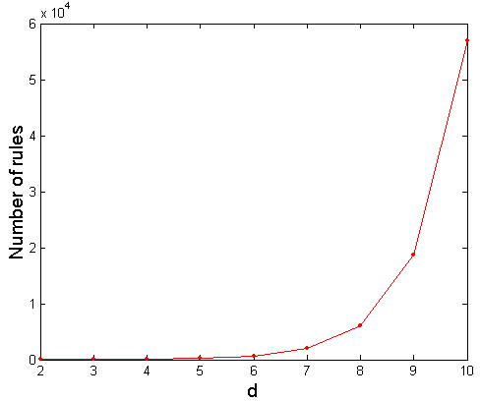
Computational Complexity
Given d unique items:
Total number of itemsets = 2^{d}
Total number of possible association rules:
If d=6, R = 602 rules
Note: {…} → ø and ø → {…} not allowed
Notes:
k is het aantal elementen van alle items in de regel; k loopt van 1 tot d
Er zijn d boven k manieren om een itemset van lengte k te maken uit d items
Vervolgens moet je de k itemset gaan splitsen tussen j voor de pijl en k-j na de pijl
Ook hiervoor zijn weer k boven j mogelijkheden, maar j mag geen 0 of k zijn
Andere redenering: elk item kan of voor de pijl, of na de pijl, of niet voorkomen: 3 tot de macht d.
Maar: er zijn geen regels met niets voor de pijl: -2 tot de macht d, en geen regels met niets na de pijl:
Nog een keer -2 tot de macht d. Maar nu hebben we niets -> niets een keer te veel afgetrokken, dus +1!

Slide 12
Frequent Itemset Generation Strategies
Reduce the number of candidates (M)
Complete search: M=2^{d}
Use pruning techniques to reduce M
Reduce the number of transactions (N)
Reduce size of N as the size of itemset increases
Used by Direct Hash & Pruning and vertical-based mining algorithms
Reduce the number of comparisons (N M)
Use efficient data structures to store the candidates or transactions
No need to match every candidate against every transaction

Slide 13
Reducing Number of Candidates
Apriori principle:
If an itemset is frequent, then all of its subsets must also be frequent
Apriori principle holds due to the following property of the support measure:
Support of an itemset never exceeds the support of its subsets
This is known as the monotone property of support

Slide 14
Illustrating Apriori Principle
Found to be infrequent
Pruned supersets
14

Slide 15
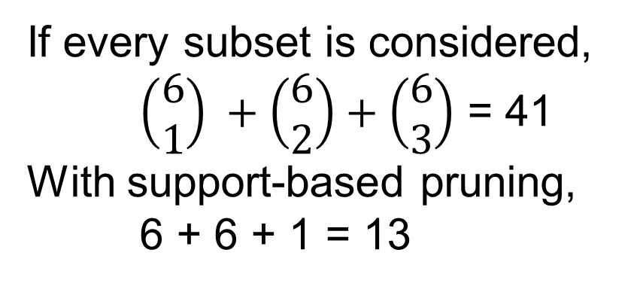
Illustrating Apriori Principle
Items (1-itemsets)
Pairs (2-itemsets)
(No need to generate candidates involving Coke or Eggs)
Minimum Support = 3
Triplets (3-itemsets)
If every subset is considered,
$\left(\begin{matrix}6 \\ 1\end{matrix}\right) +\left(\begin{matrix}6 \\ 2\end{matrix}\right)+\left(\begin{matrix}6 \\ 3\end{matrix}\right)$ = 41
With support-based pruning,
6 + 6 + 1 = 13
15

Slide 16
Apriori Algorithm
Let k=1
Generate frequent itemsets of length 1
Repeat until no new frequent itemsets are identified
Generate length (k+1) candidate itemsets from length k frequent itemsets
Prune candidate itemsets containing subsets of length k that are infrequent
Count the support of each candidate by scanning the DB
Eliminate candidates that are infrequent, leaving only those that are frequent

Slide 17
Reducing Number of Comparisons
Candidate counting:
Scan the database of transactions to determine the support of each candidate itemset
To reduce the number of comparisons, store the candidates in a hash structure
Instead of matching each transaction against every candidate, match it against candidates contained in the hashed buckets

Slide 18
Computing the support
Example: candidate itemsets with 3 items out of 9 products: {1,2,4}, {1,2,5}, {1,3,6}, {1,4,5}, {1,5,9}, {2,3,4}, {3,4,5}, {3,5,6}, {3,5,7}, {3,6,7}, {3,6,8}, {4,5,7}, {4,5,8}, {5,6,7}, {6,8,9}
New transaction t: {1,2,3,5,6}
Plan:
Consider all ordered 3-item subsets in the transaction
Compare them against all candidate itemsets
If there’s a match, the support of the corresponding candidate itemset gets +1
Do this for all transactions
Additional trick: store the candidate itemsets in a (hash) structure
Hash Function
1,4,7
3,6,9
2,5,8

Slide 19
All ordered 3-item subsets
Given a transaction t, what are the possible subsets of size 3?
19
Notes:
Voorbereiding op de volgende slide. Gegeven een geordende transactie kun je vrij eenvoudig alle mogelijke geordende subsets van lengte 3 genereren. Bij de corresponderende mogelijk frequente itemsets moet je dan 1 op gaan tellen bij het voorkomen ervan.

Slide 20
Generate Hash Tree
Hash Function
Candidate Hash Tree
1,4,7
3,6,9
2,5,8
2 3 4
5 6 7
1 4 5
1 3 6
3 4 5
3 5 6
3 6 7
3 5 7
3 6 8
1 2 4
1 5 9
6 8 9
1 2 5
4 5 7
4 5 8
Notes:
Hash: rest van deling door 3. We gaan transacties straks ordenen. Je kunt dus 1,3,4 krijgen, maar niet 3,1,4. Een hash functie {1,2,3} {4,5,6} {7,8,9} is dan niet handig, omdat het gros van de mandjes dezelfde tak zal nemen de hash dus geen splitsing aanbrengt. We willen juist een hash die een ondiepe boom oplevert, zodat we weinig vergelijkingen nodig hebben.

Slide 21
Generate Hash Tree
Hash Function
Candidate Hash Tree
1,4,7
3,6,9
2,5,8
2 3 4
5 6 7
1 4 5
1 3 6
Hash on 1, 4 or 7
3 4 5
3 5 6
3 6 7
3 5 7
3 6 8
1 2 4
1 5 9
6 8 9
1 2 5
4 5 7
4 5 8
Notes:
Hash: rest van deling door 3. We gaan transacties straks ordenen. Je kunt dus 1,3,4 krijgen, maar niet 3,1,4. Een hash functie {1,2,3} {4,5,6} {7,8,9} is dan niet handig, omdat het gros van de mandjes dezelfde tak zal nemen de hash dus geen splitsing aanbrengt. We willen juist een hash die een ondiepe boom oplevert, zodat we weinig vergelijkingen nodig hebben.

Slide 22
Generate Hash Tree
Hash Function
Candidate Hash Tree
1,4,7
3,6,9
2,5,8
2 3 4
5 6 7
1 4 5
1 3 6
Hash on 2, 5 or 8
3 4 5
3 5 6
3 6 7
3 5 7
3 6 8
1 2 4
1 5 9
6 8 9
1 2 5
4 5 7
4 5 8
Notes:
Zelfde, maar dan voor rechtdoor...

Slide 23
Generate Hash Tree
Hash Function
Candidate Hash Tree
1,4,7
3,6,9
2,5,8
2 3 4
5 6 7
1 4 5
1 3 6
Hash on 3, 6 or 9
3 4 5
3 5 6
3 6 7
3 5 7
3 6 8
1 2 4
1 5 9
6 8 9
1 2 5
4 5 7
4 5 8
Notes:
… en voor rechtsaf.

Slide 24
Subset Operation Using Hash Tree
Hash Function
1 2 3 5 6
transaction
1 +
2 3 5 6
1,4,7
3,6,9
2 +
3 5 6
3 +
5 6
2,5,8
2 3 4
5 6 7
1 4 5
1 3 6
3 4 5
3 5 6
3 6 7
3 5 7
3 6 8
1 2 4
1 5 9
6 8 9
1 2 5
4 5 7
4 5 8
24
Notes:
In de hash tree werkt dit als een streep. Subsets beginnend met een 1 linksaf, met een 2 rechtdoor, en met een 3 rechtsaf. Je gaat zo door tot je bij een blad uitkomt.

Slide 25
Subset Operation Using Hash Tree
Hash Function
1 2 3 5 6
transaction
1 +
2 3 5 6
1,4,7
3,6,9
2 +
3 5 6
3 +
5 6
2,5,8
1 2 +
3 5 6
1 3 +
5 6
2 3 4
1 5 +
6
5 6 7
1 4 5
1 3 6
3 4 5
3 5 6
3 6 7
3 5 7
3 6 8
1 2 4
1 5 9
6 8 9
1 2 5
4 5 7
4 5 8
25
Notes:
In de hash tree werkt dit als een streep. Subsets beginnend met een 1 linksaf, met een 2 rechtdoor, en met een 3 rechtsaf. Je gaat zo door tot je bij een blad uitkomt.

Slide 26
Subset Operation Using Hash Tree
Hash Function
1 2 3 5 6
transaction
1 +
2 3 5 6
1,4,7
3,6,9
2 +
3 5 6
3 +
5 6
2,5,8
1 2 +
3 5 6
1 3 +
5 6
2 3 4
Match transaction against 9 out of 15 candidates
1 5 +
6
5 6 7
1 4 5
1 3 6
3 4 5
3 5 6
3 6 7
3 5 7
3 6 8
1 2 4
1 5 9
6 8 9
1 2 5
4 5 7
4 5 8
26
Notes:
Je komt dan uit bij de rode blokken. De overige mogelijke frequente itemsets zijn sowieso uitgesloten. Bij de rode blokken moet je checken of de frequente itemsets in deze blokken inderdaad een subset zijn van de transactie. Dit is dan snel te zien.

Slide 27
Factors Affecting Complexity
Choice of minimum support threshold
lowering support threshold results in more frequent itemsets
this may increase number of candidates and max length of frequent itemsets
Dimensionality (number of items) of the data set
more space is needed to store support count of each item
if number of frequent items also increases, both computation and I/O costs may also increase
Size of database
since Apriori makes multiple passes, run time of algorithm may increase with number of transactions
Average transaction width
transaction width increases with denser data sets
this may increase max length of frequent itemsets and traversals of hash tree (number of subsets in a transaction increases with its width)
27

Slide 28
Compact Representation of Frequent Itemsets
Some itemsets are redundant because they have identical support as their supersets
Number of frequent itemsets
Need a compact representation
28

Slide 29
Factors Affecting Complexity
An itemset is closed if none of its immediate supersets has the same support as the itemset
Compact representation of itemsets without loss of support info
29

Slide 30
Maximal Frequent Itemset
An itemset is maximal frequent if none of its immediate supersets is frequent
disadvantage: no info about support of subsets
Maximal itemsets
Infrequent itemsets
Border
30

Slide 31
Maximal vs Closed Itemsets
Transaction Ids
Not supported by any transactions
31

Slide 32
Maximal vs Closed Frequent Itemsets
Closed but not maximal
Minimum support = 2
Closed and maximal
# Closed = 9
# Maximal = 4
32

Slide 33
Maximal vs Closed Itemsets
33

Slide 34
Alternative Methods for Frequent Itemset Generation
General-to-specific (as Apriori) vs Specific-to-general

Slide 35
Alternative Methods for Frequent Itemset Generation
Equivalent Classes

Slide 36
Alternative Methods for Frequent Itemset Generation
Breadth-first vs depth-first

Slide 37
Rule Generation
Given a frequent itemset L, find all non-empty subsets f ⊂ L such that f → L – f satisfies the minimum confidence requirement
If {A,B,C,D} is a frequent itemset, candidate rules: ABC → D, ABD → C, ACD → B, BCD → A, A → BCD, B → ACD, C → ABD, D → ABC, AB → CD, AC → BD, AD → BC, BC → AD, BD → AC, CD → AB
If |L| = k, then there are 2^{k} – 2 candidate association rules (ignoring L → ∅ and ∅ → L)
37

Slide 38
Rule Generation
How to efficiently generate rules from frequent itemsets?
In general, confidence does not have a monotone property: c(ABC →D) can be larger or smaller than c(AB →D)
But confidence of rules generated from the same itemset does have a monotone property
For example, L = {A,B,C,D}: c(ABC → D) ≥ c(AB → CD) ≥ c(A → BCD)
Confidence is a decreasing function of the number of items on the RHS of the rule
38

Slide 39
Rule Generation for Apriori Algorithm
Low Confidence Rule
Lattice of rules
Pruned Rules
39

Slide 40
Rule Generation for Apriori Algorithm
Candidate rule is generated by merging two rules that share the same prefix in the rule consequent
join(CD=>AB,BD=>AC) would produce the candidate rule D => ABC
Prune rule D=>ABC if its subset AD=>BC does not have high confidence
40

Slide 41
Pattern Evaluation
Association rule algorithms tend to produce too many rules
many of them are uninteresting or redundant
redundant if {A,B,C} → {D} and {A,B} → {D} have the same support and confidence
Interestingness measures can be used to prune/rank the derived patterns
In the original formulation of association rules, support and confidence are the only measures used
41

Slide 42
Application of Interestingness Measure
Interestingness Measures
42

Slide 43
Computing Interestingness Measure
Given a rule X → Y, information needed to compute rule interestingness can be obtained from a contingency table
 | Y | Y
X | f₁₁ | f₁₀ | f₁₊
X | f₀₁ | f₀₀ | f_{o+}
 | f₊₁ | f₊₀ | |T|
f₁₁: support of X and Y f₁₀: support of X and Y f₀₁: support of X and Y f₀₀: support of X and Y
Used to define various measures:
support, confidence, lift, Gini, J-measure, etc.
43

Slide 44
Drawback of Confidence
 | Coffee | Coffee
Tea | 15 | 5 | 20
Tea | 75 | 5 | 80
 | 90 | 10 | 100
Association rule: Tea → Coffee
Confidence = P(Coffee|Tea) = 0.75
But P(Coffee) = 0.9
Although confidence is high, rule is uninteresting
P(Coffee|Tea) = 0.9375
44

Slide 45
Statistical Independence
Population of 1000 students
600 students know how to swim (S)
700 students know how to bike (B)
420 students know how to swim and bike (S,B)
P(S∧B) = 420/1000 = 0.42
P(S) × P(B) = 0.6 × 0.7 = 0.42
P(S∧B) = P(S) × P(B) => Statistical independence
P(S∧B) > P(S) × P(B) => Positively correlated
P(S∧B) < P(S) × P(B) => Negatively correlated
45

Slide 46
Statistical-based Measures
Measures that take into account statistical dependence
46

Slide 47
Example: Lift/Interest
 | Coffee | Coffee
Tea | 15 | 5 | 20
Tea | 75 | 5 | 80
 | 90 | 10 | 100
Association rule: Tea → Coffee
Confidence = P(Coffee|Tea) = 0.75
But P(Coffee) = 0.9
Lift = 0.75/0.9= 0.8333 (< 1, therefore is negatively associated)
47

Slide 48
Drawback of Lift and Interest
 | Y | Y
X | 10 | 0 | 10
X | 0 | 90 | 90
 | 10 | 90 | 100
 | Y | Y
X | 90 | 0 | 90
X | 0 | 10 | 10
 | 90 | 10 | 100
Not invariant under inversion operation (0 →1 and 1→0)
48

Slide 49
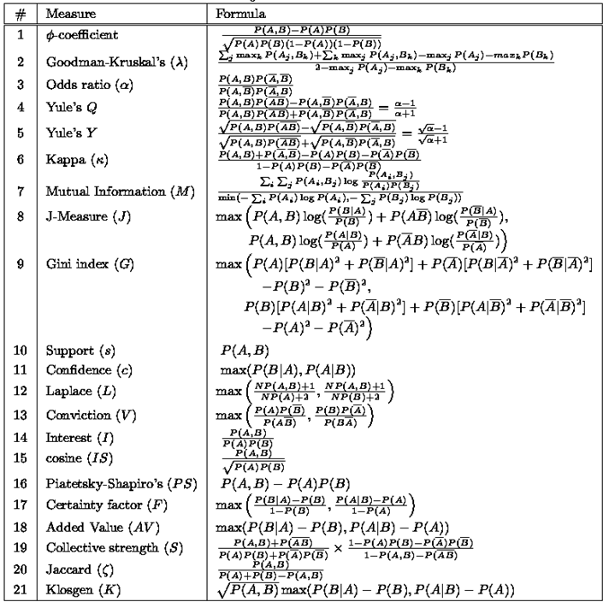
Interestingness Measures (1)

Slide 50
Interestingness Measures (2)

Slide 51
Interestingness Measures
There are lots of measures of interestingness proposed in the literature
Some measures are good for certain applications, but not for others
What criteria should we use to determine whether a measure is good or bad?
What about Apriori-style support based pruning? How does this affect these measures?

Slide 52
Properties of A Good Measure
Piatetsky-Shapiro: 3 properties a good measure M must satisfy:
M(A,B) = 0 if A and B are statistically independent
M(A,B) increase monotonically with P(A,B) when P(A) and P(B) remain unchanged
M(A,B) decreases monotonically with P(A) [or P(B)] when P(A,B) and P(B) [or P(A)] remain unchanged
52

Slide 53
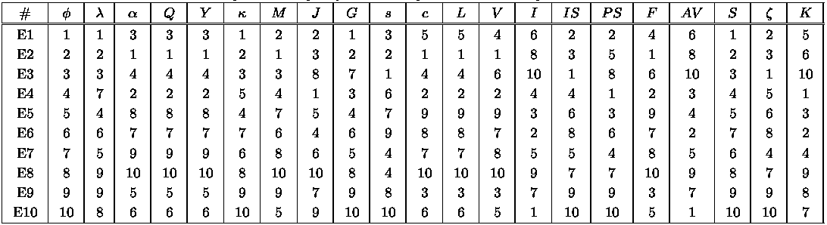
Comparing Different Measures
10 examples of contingency tables:
Rankings of contingency tables using various measures:
53

Slide 54
Property under Variable Permutation
Does M(A,B) = M(B,A)?
Symmetric measures: support, lift, collective strength, cosine, Jaccard, etc
Asymmetric measures: confidence, conviction, Laplace, J-measure, etc
54

Slide 55
Property under Row/Column Scaling
Grade-Gender Example (Mosteller, 1968):
2x 10x
Mosteller: Underlying association should be independent of the relative number of male and female students in the samples
 | Male | Female
High | 1 | 4 | 5
Low | 2 | 3 | 5
 | 3 | 7 | 10
 | Male | Female
High | 2 | 40 | 34
Low | 4 | 30 | 42
 | 6 | 70 | 76
Notes:
NB: heeft niets te maken met Simpson’s paradox. Aantal mannen en vrouwen neemt onevenredig toe. Als je wilt dat de conclusies (mannen 2x meer lage dan hoge score; vrouwen 4 staat tot 3) onafhankelijk zijn van het schalen van de kolom, zal je maat van interessantheid daar invariant voor moeten zijn. Iets soortgelijks voor rijen.

Slide 56
Property under Inversion Operation
Transaction 1
.
.
.
.
.
Transaction N
56

Slide 57
Example: φ-Coefficient
φ-coefficient is analogous to correlation coefficient for continuous variables
invariant under inversion operation
 | Y | Y
X | 60 | 10 | 70
X | 10 | 20 | 30
 | 70 | 30 | 100
 | Y | Y
X | 20 | 10 | 30
X | 10 | 60 | 70
 | 30 | 70 | 100

Slide 58
Property under Null Addition
Invariant measures: support, cosine, Jaccard, ...
Non-invariant measures: correlation, Gini, mutual information, odds ratio...

Slide 59
Different Measures have Different Properties
59

Slide 60
Support-based Pruning
Most of the association rule mining algorithms use support measure to prune rules and itemsets
Study effect of support pruning on correlation of itemsets
Generate 10000 random contingency tables
Compute support and pairwise correlation for each table
Apply support-based pruning and examine the tables that are removed
60

Slide 61
Effect of Support-based Pruning
61

Slide 62
Effect of Support-based Pruning
Support-based pruning eliminates mostly negatively correlated itemsets
62

Slide 63
Effect of Support-based Pruning
Investigate how support-based pruning affects other measures
Steps:
Generate 10000 contingency tables
Rank each table according to the different measures
Compute the pair-wise correlation between the measures
63

Slide 64
Effect of Support-based Pruning
Without support pruning (all pairs)
Red cells indicate correlation between the pair of measures > 0.85
40.14% pairs have correlation > 0.85
Scatter Plot between Correlation & Jaccard Measure
64

Slide 65
Effect of Support-based Pruning
0.5% ≤ support ≤ 50%
61.45% pairs have correlation > 0.85
Scatter Plot between Correlation & Jaccard Measure
65
Notes:
Als we alleen kijken naar contingentietabellen die een fatsoenlijke support opleveren, nemen de correlaties toe en beginnen de maten van interessantheid steeds meer op elkaar te lijken

Slide 66
Effect of Support-based Pruning
0.5% ≤ support ≤ 30%
76.42% pairs have correlation > 0.85
Scatter Plot between Correlation & Jaccard Measure
66
Notes:
Wanneer we de support verder beperken tot een redelijk bereik, nemen de correlaties alleen nog maar verder toe.

Slide 67
Subjective Interestingness Measure
Objective measure:
Rank patterns based on statistics computed from data
e.g., 21 measures of association (support, confidence, Laplace, Gini, mutual information, Jaccard, etc).
Subjective measure (Silberschatz & Tuzhilin):
Rank patterns according to user’s interpretation
A pattern is subjectively interesting if it contradicts the expectation of a user
A pattern is subjectively interesting if it is actionable
67

Slide 68
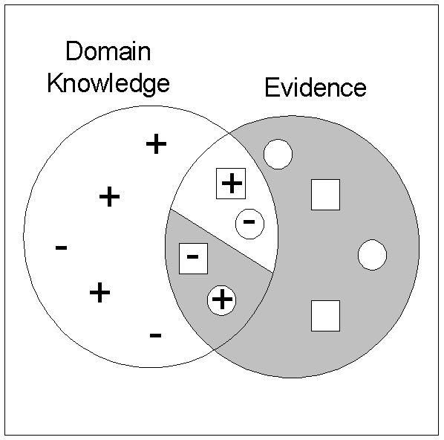
Interestingness via Unexpectedness
Need to model expectation of users (domain knowledge)
Need to combine expectation of users with evidence from data (i.e., extracted patterns)
+
Pattern expected to be frequent
-
Pattern expected to be infrequent
Pattern found to be frequent
Pattern found to be infrequent
+
-
Expected Patterns
-
+
Unexpected Patterns
68

Slide 69
Association rule mining
Find potentially interesting association rules
Main technical challenge is the computational complexity
Various tricks to make this work in practice:
First search for frequent itemsets, only then for interesting rules
Monotonicity properties of support and confidence
Clever ways to compare transactions against candidate itemsets
Many different measures of “interestingness”, typically highly correlated in practice
Real challenge is to find associations that are surprising and actionable

